Slide 1


Department Of Computer Science And Engineering Computer Science And Design Program
Topic: AI Powered Medical Chatbot
Presented by
Madiha Azam : 3PD22CG048
Bhagyashree C :3PD22CG006
Bhagyashree G :3PD22CG007
Guided by
Dr. Prakash Pattan

Slide 2
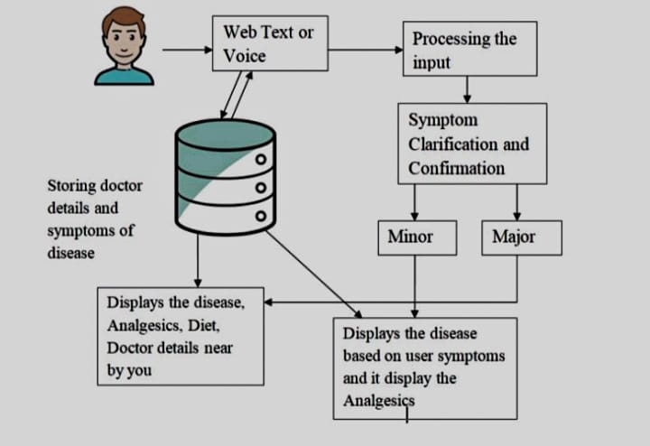
Introduction
AI-powered medical chatbots are reshaping healthcare by offering quick and efficient medical support. Chatbots use advanced AI, including multimodal Large Language Models (LLMs) l to process both text and images for better diagnosis and medical assistance. This enables users to receive instant health advice, symptom analysis, and medication guidance without waiting for a doctor’s appointment. By integrating vision and text-based understanding, the chatbot enhances accuracy and provides more personalized responses. While it helps reduce the burden on healthcare professionals and improves patient accessibility, challenges such as data security, reliability, and compliance with medical regulations must be addressed.

Slide 3
Abstract
AI-powered medical chatbot uses advanced technology to understand both text and images, providing quick and accurate medical insights. Built with Groq’s multimodal Large Language Model (LLM), it can analyze symptoms, interpret medical images, and offer helpful health guidance. The chatbot assists users with symptom checking, basic diagnosis, medication advice, and appointment reminders. By combining text and vision capabilities, it delivers more accurate and relevant responses, making healthcare support more accessible and efficient. While this technology improves patient care and reduces the workload on doctors, challenges like data privacy and accuracy need to be carefully managed. Overall, this chatbot shows how AI can improve digital healthcare and make medical help available anytime, anywhere.

Slide 4
Literature survey
Paper title | Author | Pros | Cons
Chatbot for Healthcare System Using AI | Athota et al. | Demonstrates the potential of AI-powered chatbots in providing accurate medical information and assistance. | May require significant computational resources for real-time processing.
Automatized Medical Chatbot (Medibot) | Srivastava and Singh | Highlights the importance of personalized healthcare solutions. | Development of specialized chatbots may limit scalability.
E-Health Bot to Change the Face of Medicare | Tanmay et al. | Illustrates the transformative potential of chatbots in reshaping healthcare delivery models. | Reliance on real-time data may introduce challenges in data accuracy and integration.
Chatbot for Disease Prediction and Treatment Recommendation using ML | Mathew et al. | Focuses on enhancing predictive capabilities of medical chatbots through machine learning techniques. | May face challenges in interpreting complex medical data accurately, leading to potential misdiagnosis or recommendations.

Slide 5
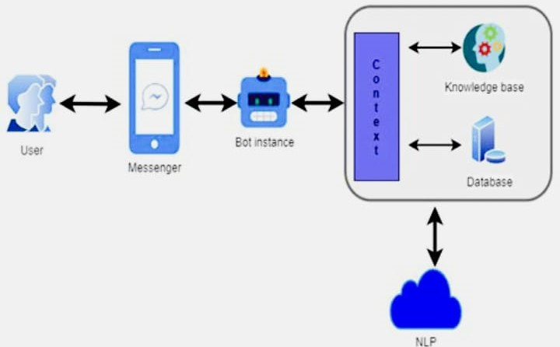
Requirement Analysis
Functional Requirements:
Process both text and image inputs using Groq’s multimodal LLM
Provide real-time and accurate medical insights.
Support multilingual communication for accessibility.
Offer symptom assessment and medical recommendations.
Non-Functional Requirements:
Ensure a user-friendly and intuitive interface.
Comply with healthcare privacy regulations (HIPAA, GDPR).
Maintain high scalability and fast response times.
Requirements
Hardware: Cloud-based servers, GPUs/TPUs for AI processing.
Software: Groq AI framework, NLP engine, secure database system.

Slide 6
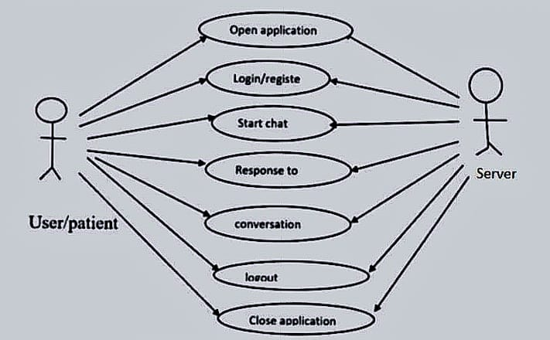
Methodology
User inputs symptoms or queries
NLP processes the input
Intent detection and entity recognition
Query matched with medical knowledge base
AI generates appropriate medical response
Response is sent to the user Optional user feedback for improvement
Use case diagram

Slide 7
conclusion
AI-powered medical chatbots are changing the way people access healthcare by providing quick and reliable medical support. With the ability to understand both text and images, these chatbots help users check symptoms, get health advice, and manage medications easily. They also reduce the workload on doctors by handling simple medical questions. While this technology makes healthcare more accessible and efficient, challenges like data privacy and accuracy must be carefully managed. With continuous improvements in AI, medical chatbots have the potential to make healthcare smarter, faster, and more convenient for everyone.

Slide 8
References
A. Athota et al., "Chatbot for Healthcare System Using AI," International Journal for Multidisciplinary Research (IJFMR), vol. 6, no. 3, May-June 2024.
R. Srivastava and S. Singh, "Automatized Medical Chatbot (Medibot)," International Journal for Multidisciplinary Research (IJFMR), vol. 6, no. 3, May-June 2024.
T. Tanmay et al., "E-Health Bot to Change the Face of Medicare," International Journal for Multidisciplinary Research (IJFMR), vol. 6, no. 3, May-June 2024.
J. Mathew et al., "Chatbot for Disease Prediction and Treatment Recommendation Using ML," International Journal for Multidisciplinary Research (IJFMR), vol. 6, no. 3, May-June 2024.

